Slide 1
Let’s Optimize Some Queries!

Slide 2
Let’s Optimize a Query (1)
SELECT * FROM STORE S LIMIT 100;
SELECT ID, NAME FROM STORE S LIMIT 100;
Let’s select only the required fields.
Eliminate unnecessary page reads if the table has BLOB or TEXT fields

Slide 3
Let’s Optimize a Query (2)
SELECT SUM(TOTAL) AS 'TOTAL_SALE'
FROM TRANSACTIONS
WHERE STORE_ID = 10058794
AND YEAR(FROM_UNIXTIME(CREATED_TIME/1000)) = 2019;
Calculate the number of disk/cache seeks that the DB engine must do in order to fulfil the query.
Optimize the query/DB to minimize the disk/cache seeks

Slide 4
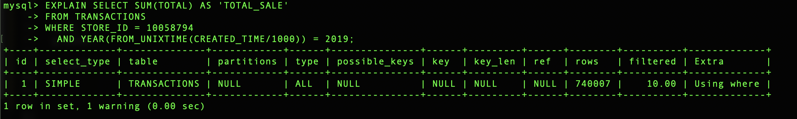
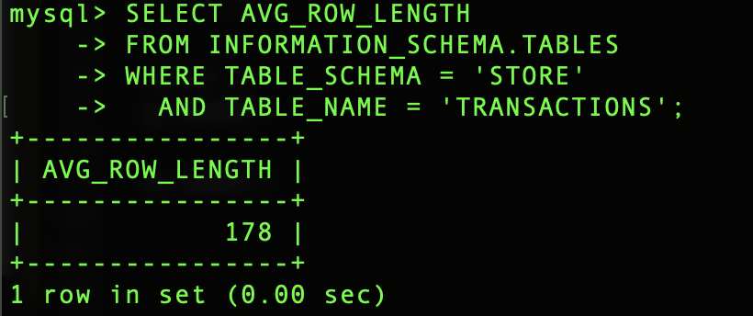
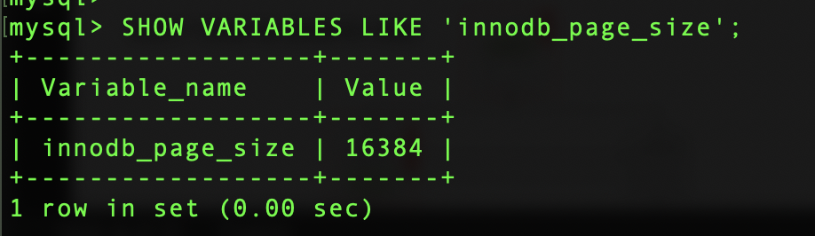
Let’s Optimize a Query (2)
740007 Rows are analyzed to fulfil the result
Average Row Size is 178 Bytes
Rows per page = 16384/178
= 92
Number of disk seeks = 740007/92
= 8044
The Page Size is 16384 Bytes

Slide 5

Let’s Optimize a Query (2)
Let’s create an index
SELECT SUM(TOTAL) AS 'TOTAL_SALE'
FROM TRANSACTIONS
WHERE STORE_ID = 10058794
AND YEAR(FROM_UNIXTIME(CREATED_TIME/1000)) = 2019;
CREATE INDEX IX_CREATED_TIME
ON TRANSACTIONS(CREATED_TIME,STORE_ID );

Slide 6
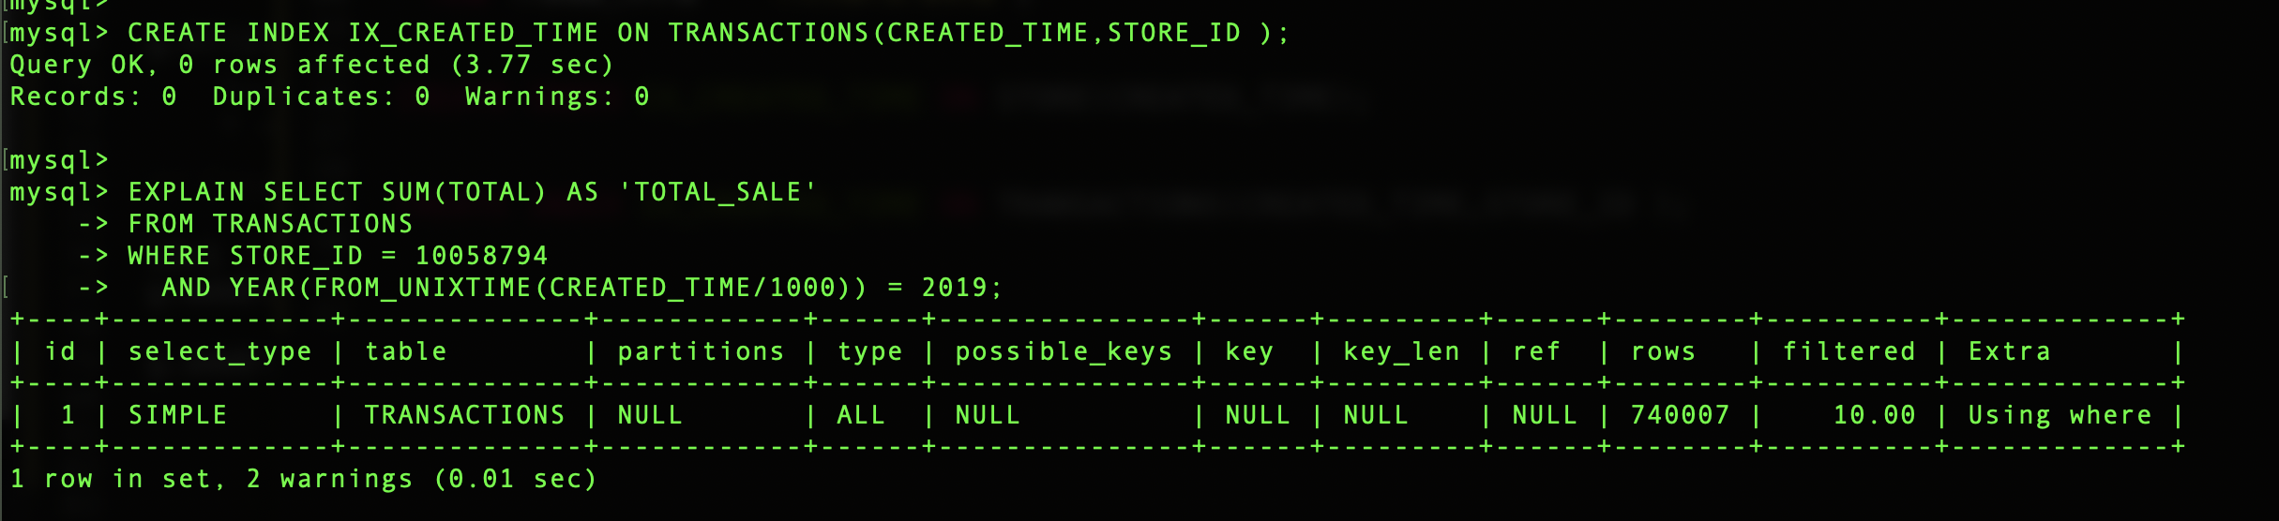
Let’s Optimize a Query (2)
Why I can’t see the index here?

Slide 7
Let’s Optimize a Query (2) - Functions
These functions cause the problem.
SELECT SUM(TOTAL) AS 'TOTAL_SALE'
FROM TRANSACTIONS
WHERE STORE_ID = 10058794
AND YEAR(FROM_UNIXTIME(CREATED_TIME/1000)) = 2019;
Functions in the WHERE clause makes it impossible optimizer to find the possible indexes.
YEAR(FROM_UNIXTIME(CREATED_TIME/1000)) => 2018 , 2019 …
These values are not available in the index.

Slide 8
Let’s Optimize a Query (2) - Functions
Let’s remove the function and rewrite the query.
SELECT SUM(TOTAL) AS 'TOTAL_SALE'
FROM TRANSACTIONS
WHERE STORE_ID = 10058794
AND CREATED_TIME BETWEEN UNIX_TIMESTAMP('2019-01-01') * 1000
AND UNIX_TIMESTAMP('2020-01-01') * 1000;

Slide 9
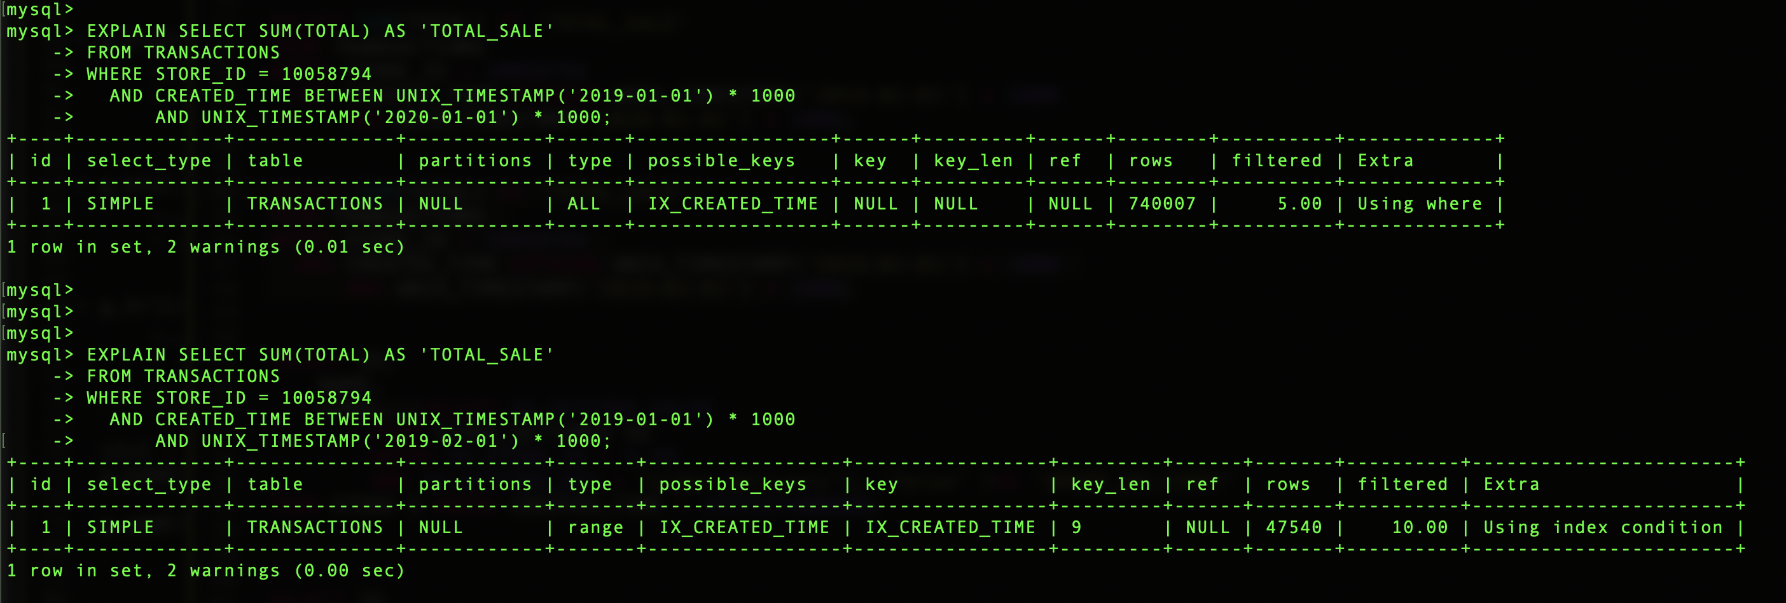
Let’s Optimize a Query (2)
The index is utilized for a shorter timeframe

Slide 10
Let’s Optimize a Query (2) – Index Cardinality
Index cardinality refers to the uniqueness of the values stores in a specified column in a index
The optimize uses the index cardinality to generate the optimal quary plan.
Index cardinality desides whther or not to use a particular index to fulfiul a qury.
If the optimizer has to reed more index pages to fulfil the query, sometimes it is more effective to scan the table than reading the index.

Slide 11
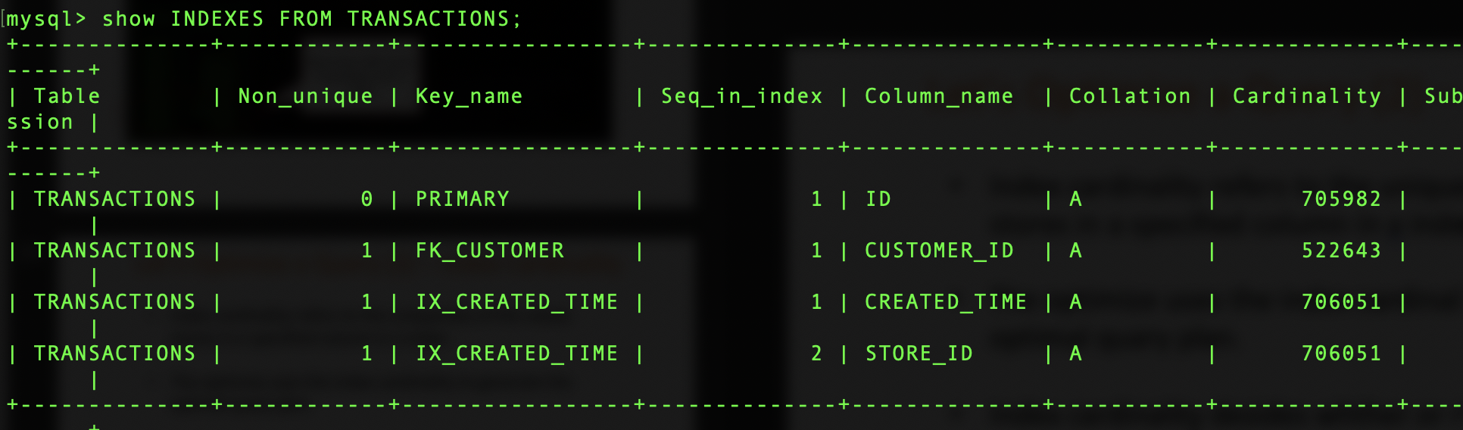
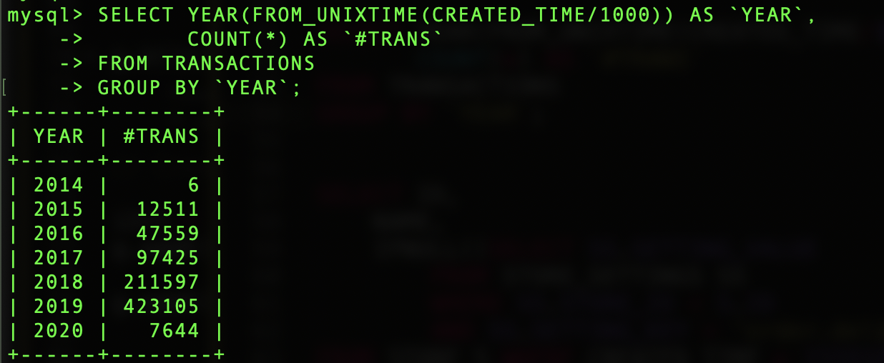
Let’s Optimize a Query (2) – Index Cardinality
Majority of rows are in 2019. Therefore, it is more effective to scan the table than reading the index

Slide 12
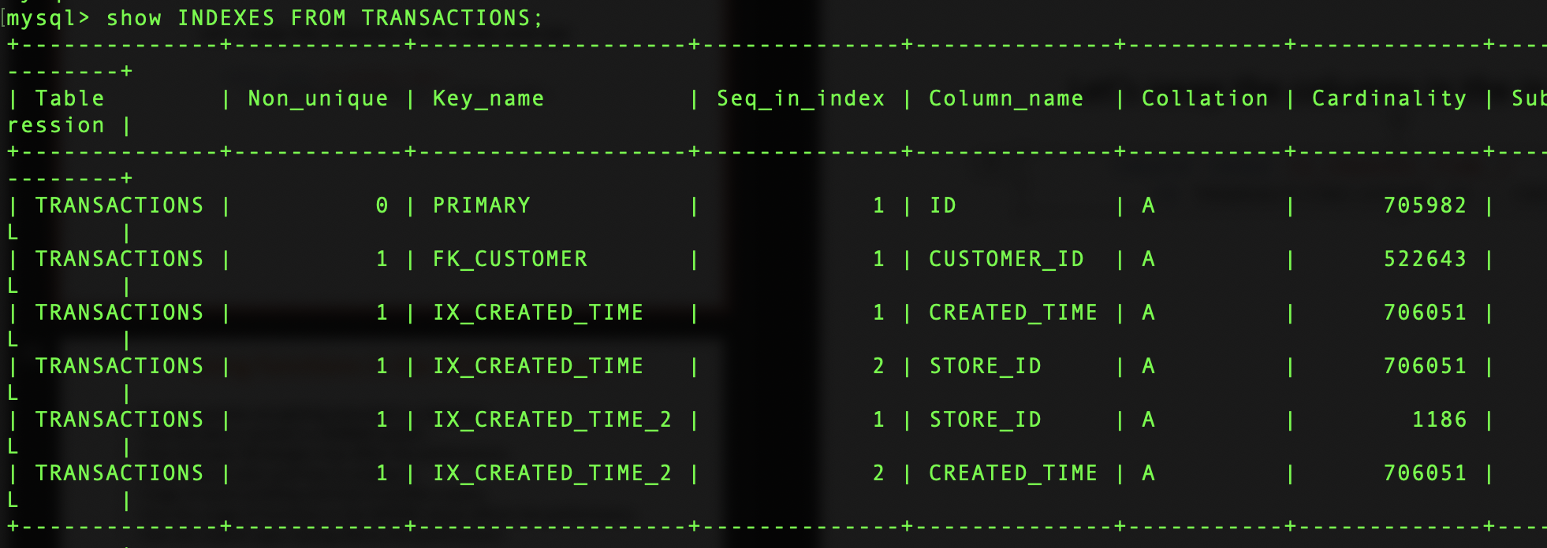
Let’s Optimize a Query (2) – Index Cardinality
Let’s swap the columns in the index and see
CREATE INDEX IX_CREATED_TIME_2
ON TRANSACTIONS(STORE_ID , CREATED_TIME);
Since we are filtering for a specific store, now the index can narrow down the result set approximately by 1000 times

Slide 13
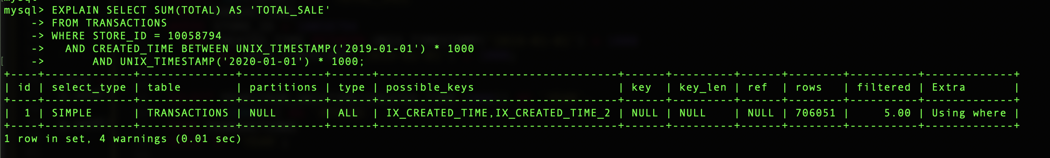
Let’s Optimize a Query (2)
#$&%@#$
Still the index is not utilized

Slide 14
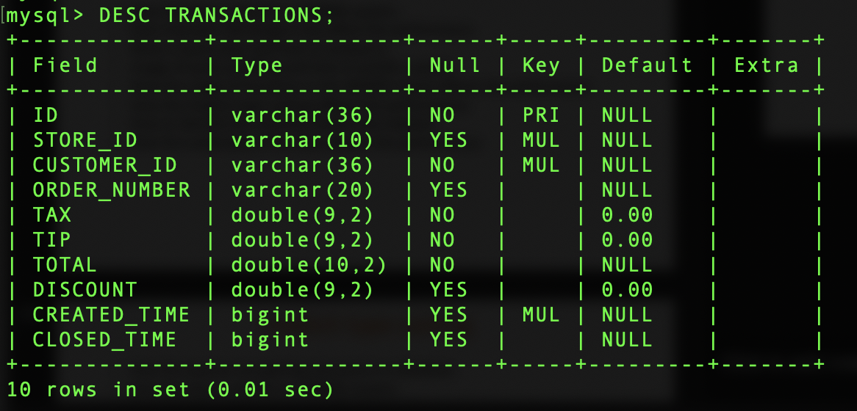
Let’s Optimize a Query (2) – Implicit Type Casting
SELECT SUM(TOTAL) AS 'TOTAL_SALE'
FROM TRANSACTIONS
WHERE STORE_ID = 10058794
AND YEAR(FROM_UNIXTIME(CREATED_TIME/1000)) = 2019;
We have passed an integer here
But the STORE_ID is a VARCHAR column

Slide 15
Let’s Optimize a Query (2) – Implicit Type Casting
When an operator is used with operands of different types, type conversion occurs to make the operands compatible.
Here the data type of the column is VARCHAR and the provided data type is INT
String-to-integer implicit type casting happens here to make the operands compatible.
That creates an invisible wrapper function like CAST(STORE_ID AS INT) on the STORE_ID column.
Which make it impossible to recognize the indexes.

Slide 16
Let’s Optimize a Query (2) – Implicit Type Casting
Let’s pass the STORE_ID as a String.
SELECT SUM(TOTAL) AS 'TOTAL_SALE'
FROM TRANSACTIONS
WHERE STORE_ID = '10058794'
AND CREATED_TIME BETWEEN UNIX_TIMESTAMP('2019-01-01') * 1000
AND UNIX_TIMESTAMP('2020-01-01') * 1000;

Slide 17
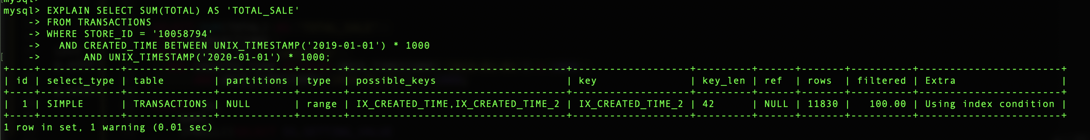
Let’s Optimize a Query (2) – Implicit Type Casting
Previously
Number of disk seeks = 740007/92
= 8044
Rows per page = 16384/178
= 92
Number of disk seeks = 11830/92
= 129

Slide 18
Let’s Optimize a Query (3)
SELECT ID,
NAME,
getStoreSettings(S.ID, 'order.delivery’)
AS 'ORDER_DELIVERY'
FROM STORE S WHERE CREATED_TIME > 1559327400000;
The reusable functions is the way of programming!
But, is it good for queries as well?
Let’s look at the query plan…

Slide 19
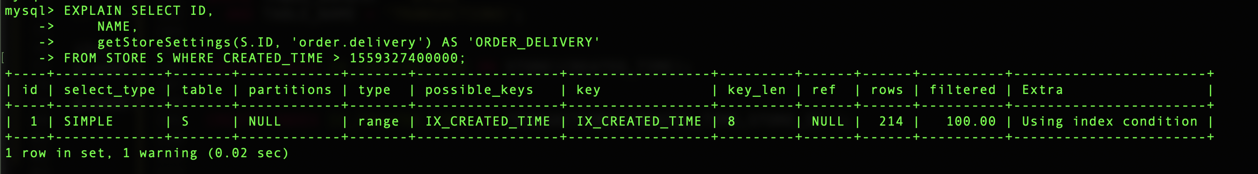
Let’s Optimize a Query (3)
The query plan looks promising...
But, is that correct?
What’s happening inside that function?
Looks like the optimizer can’t even see it…

Slide 20
Let’s Optimize a Query (3) – Dependent Subqueries
Let’s remove the function and rewrite the query
SELECT ID,
NAME,
IFNULL((SELECT SS.SETTING_VALUE
FROM STORE_SETTINGS SS
WHERE SS.STORE_ID = S.ID
AND SS.SETTING_KEY = 'order.delivery'), 'false' )AS 'ORDER_DELIVERY'
FROM STORE S
WHERE CREATED_TIME > 1559327400000;

Slide 21
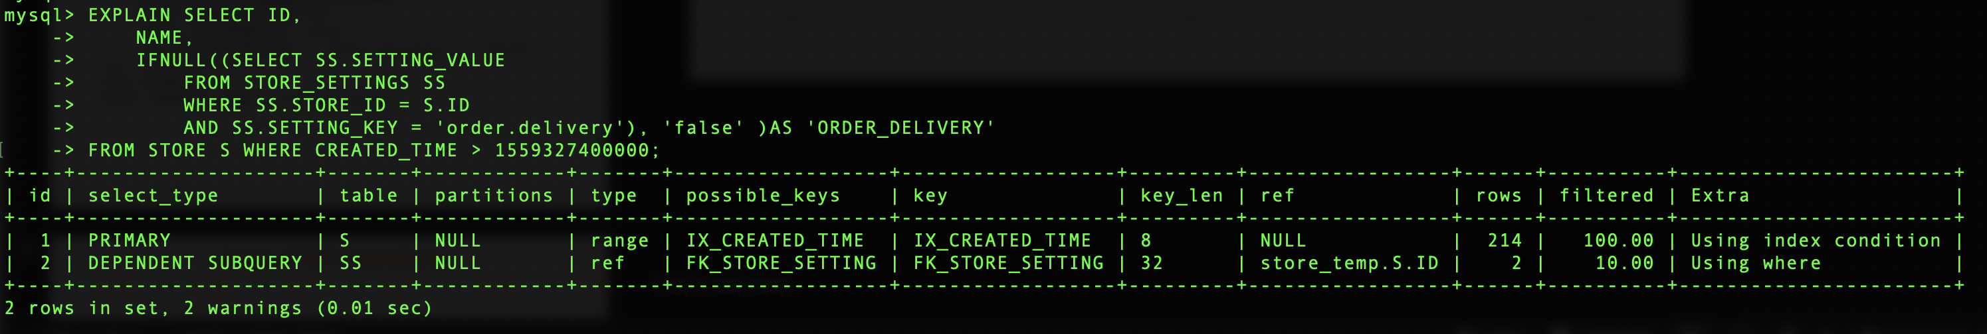
Let’s Optimize a Query (3) – Dependent Subqueries
Now the query plan looks far better…
But, is it optimal?
Let’s see how the query is actually executed...

Slide 22
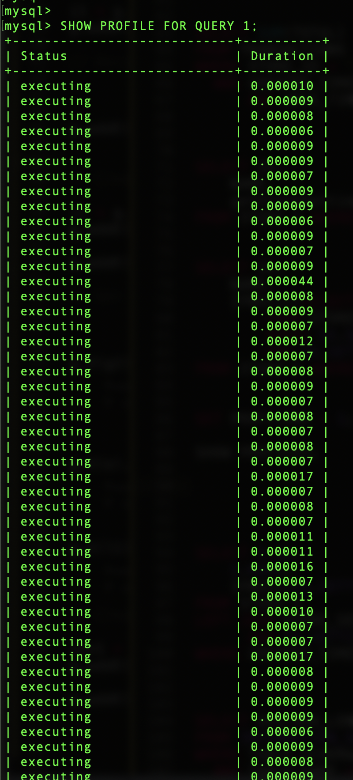
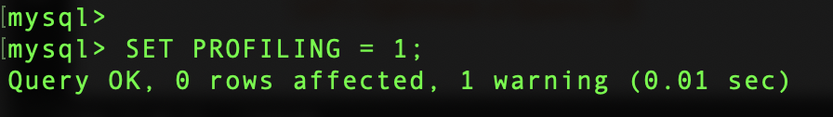
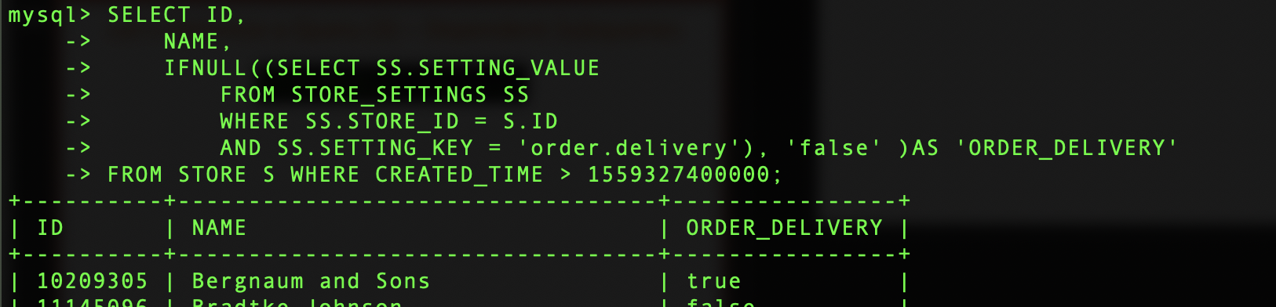
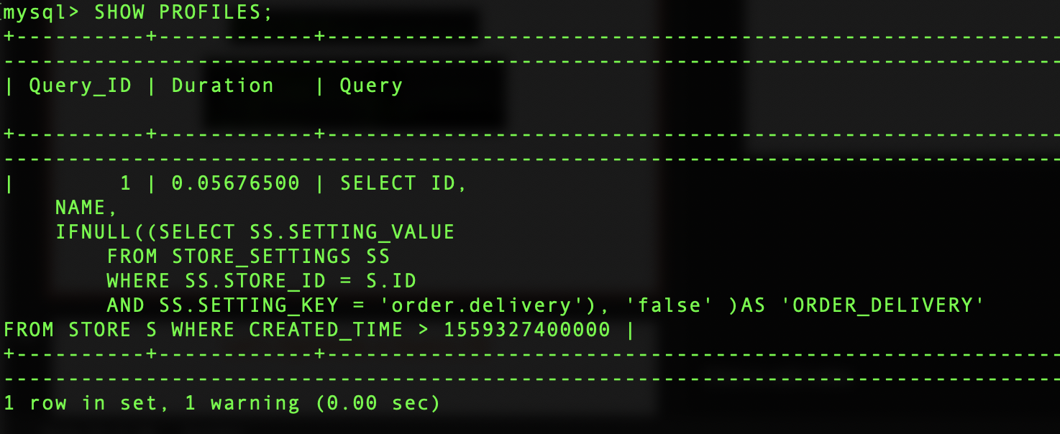
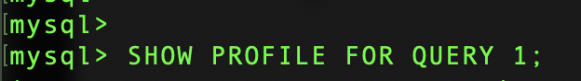
Let’s Optimize a Query (3) – Dependent Subqueries

Slide 23
Let’s Optimize a Query (3) – Dependent Subqueries
The dependent subquery is getting executed for each row in the driving table.
If the driving table has large volume of records, the query takes long time to execte.
The relational databases are optimized for set operations.
Let’s use set operations as much as possible.

Slide 24
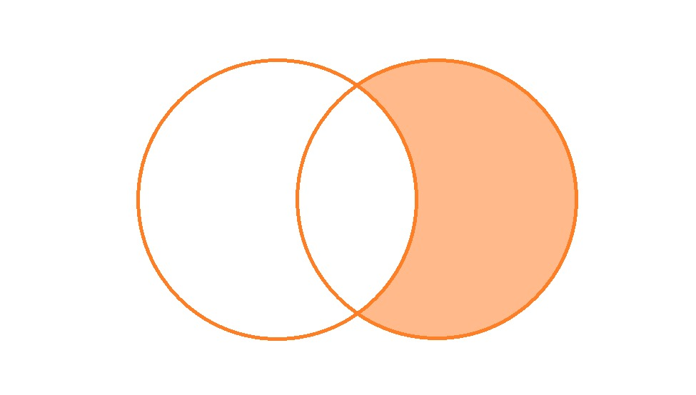
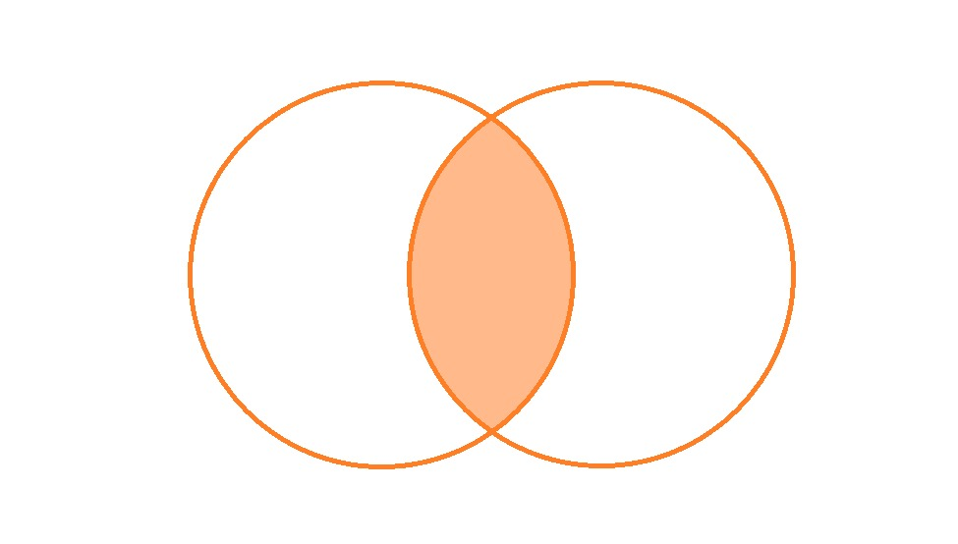
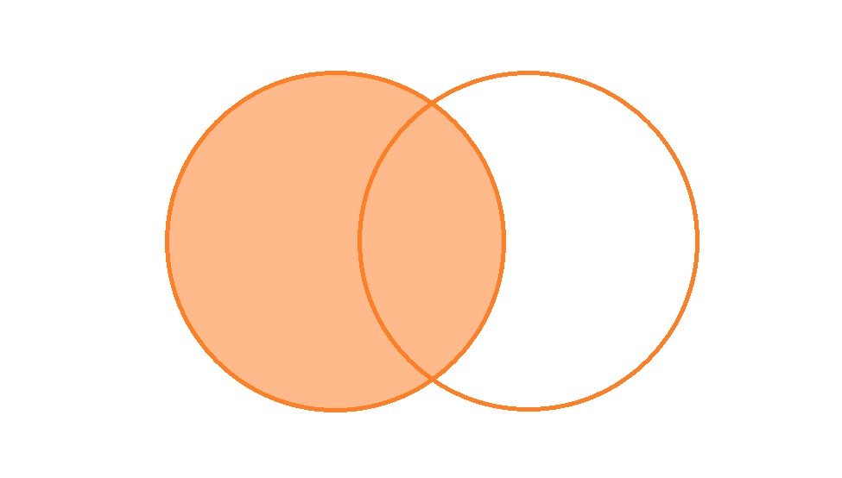
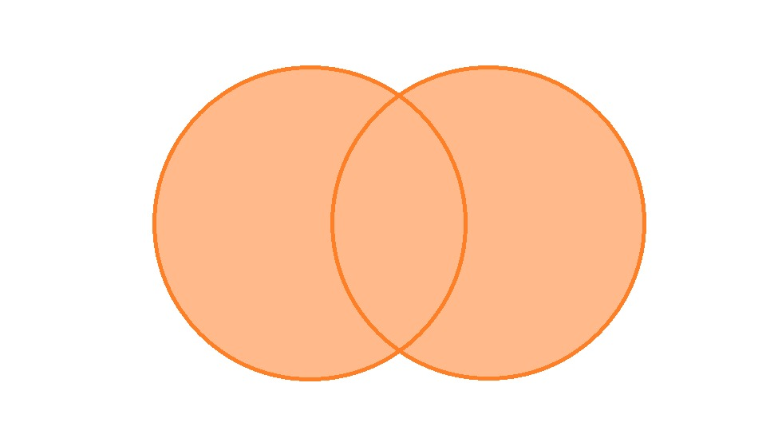
Let’s Optimize a Query (3) – Set Operations
A
B
A
B
A RIGHT OUTER JOIN B
WHERE B.ID IS NULL
A INNER JOIN B
A
B
A
B
A LEFT OUTER JOIN B
A RIGHT OUTER JOIN B
A
B
A LEFT OUTER JOIN B
WHERE B.ID IS NULL
A
B
A FULL OUTER JOIN B

Slide 25
Let’s Optimize a Query (3) – Set Operations
Let’s modify the query with set operations
SELECT S.ID,
S.NAME,
IFNULL(SS.SETTING_VALUE, 'false' ) AS 'ORDER_DELIVERY'
FROM STORE S
LEFT JOIN STORE_SETTINGS SS ON SS.STORE_ID = S.ID
AND SS.SETTING_KEY = 'order.delivery'
WHERE CREATED_TIME > 1559327400000;

Slide 26
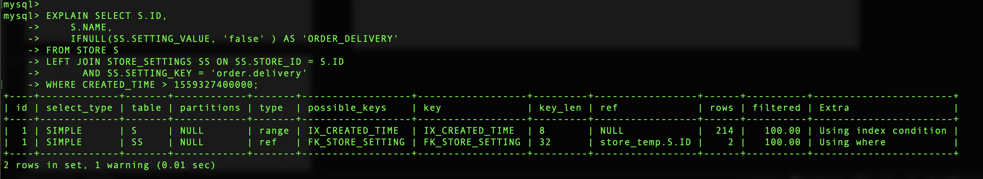
Let’s Optimize a Query (3) – Set Operations
The query plan has changed

Slide 27
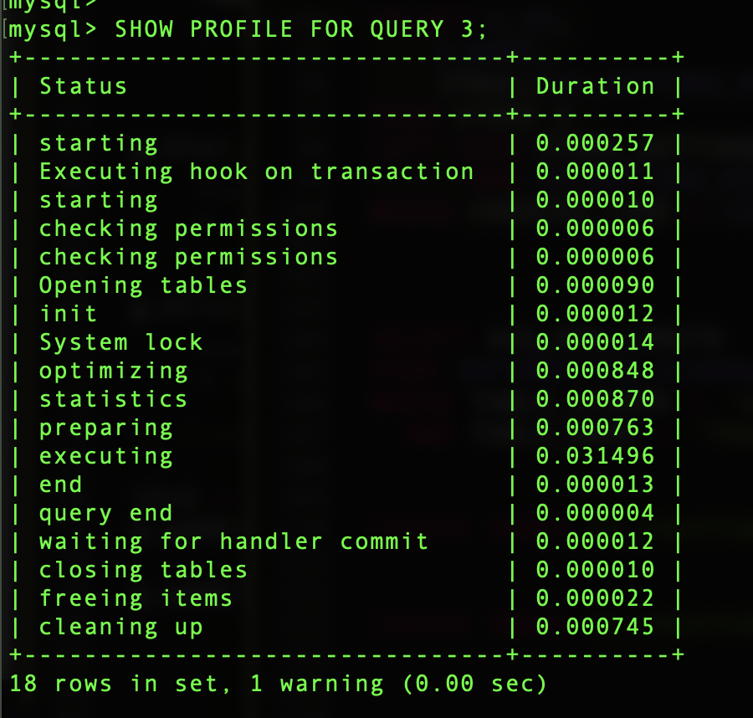
Let’s Optimize a Query (3) – Set Operations
Let’s look at how it is executed

Slide 28
Thank You

